Slide 1
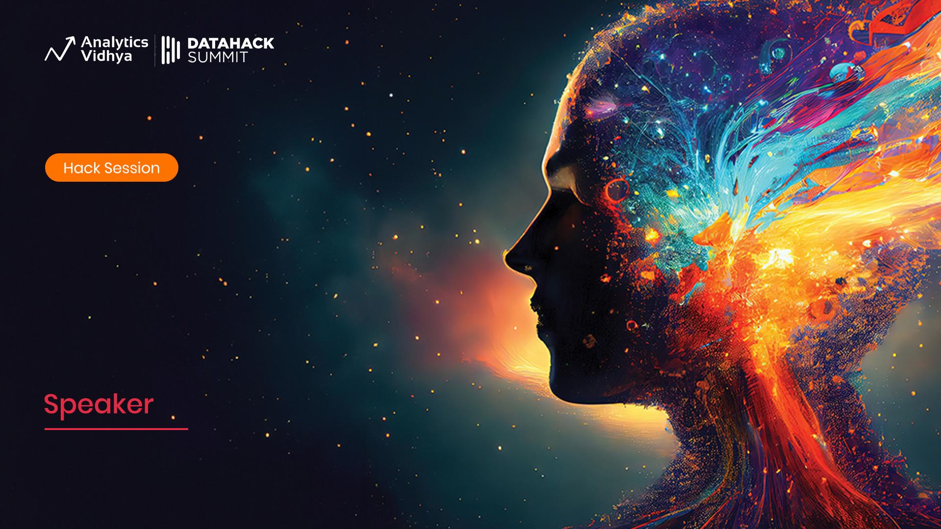
Workshop
NLP using Generative Models::
Module 01
Raghav Bali
Amar Lalwani
Staff Data Scientist
Co-Founder/Head of Data

Slide 2

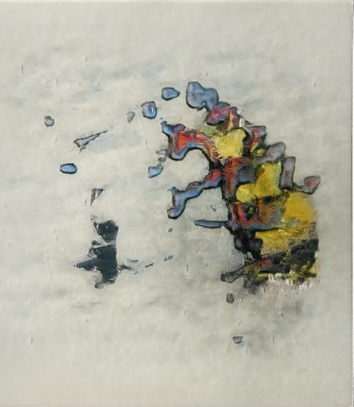
Agenda :: Module 01
What is Generative AI?
Key Domains
The NLP Journey
Image Sources:
https://thisartworkdoesnotexist .com/

Slide 3
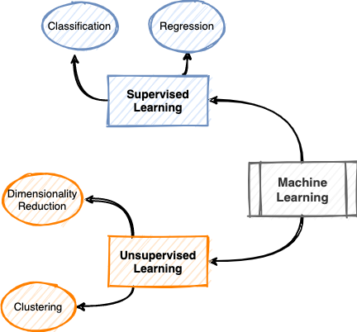
What is Generative AI?
Machine Learning Landscape
Supervised
Regression
Classification
Unsupervised
Clustering
Dimensionality Reduction

Slide 4
What is Generative AI?
Machine Learning Landscape
Supervised
Regression
Classification
Unsupervised
Clustering
Dimensionality Reduction
Discriminative Modeling

Slide 5
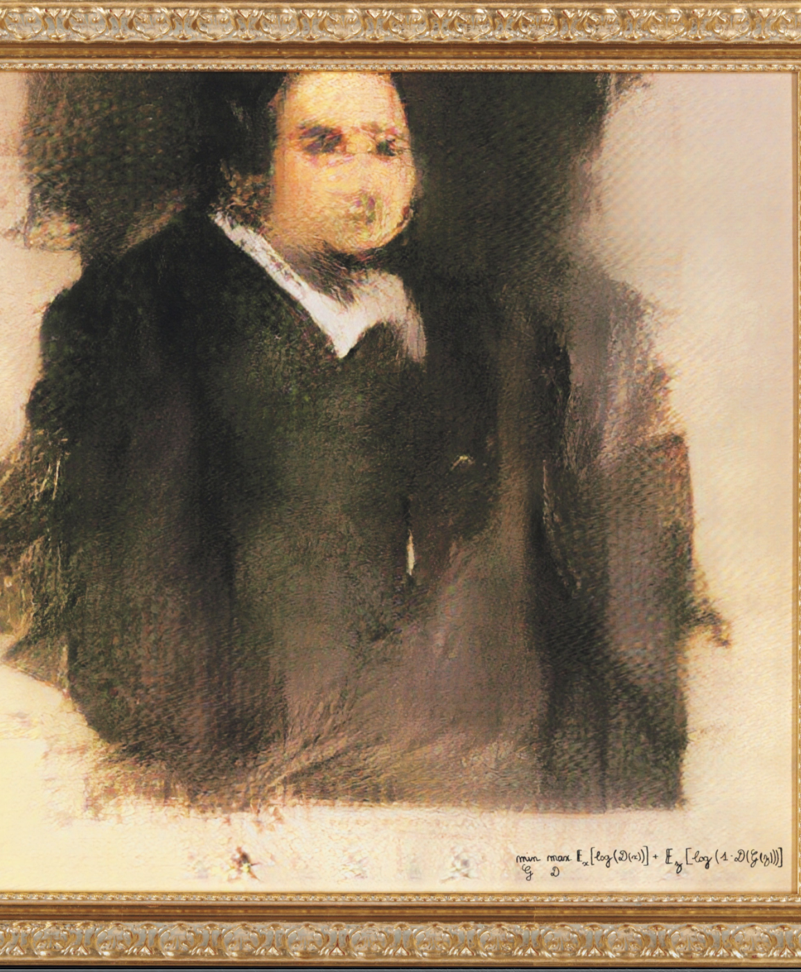
What is Generative AI?
Generative models are a class of models in the unsupervised machine learning space
These help us model the underlying distributions responsible for generating the dataset under consideration
“
There is tremendous amount of data easily accessible in most cases. Generative models analyze and understand such datasets
”

Slide 6

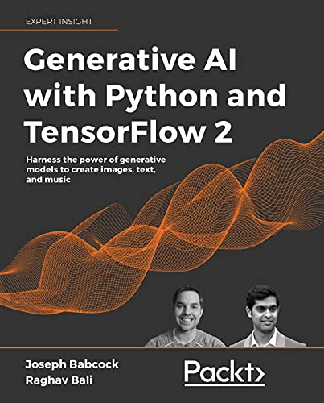
Key Domains
NLP
Text Completion
Code Generation
Computer Vision
Image Generation (text to image, image to image)
Style Transfer
Super-Resolution
Image Out-Painting
Audio
Audio Generation (text to audio, audio to audio)
Music Generation
Video
Multi-Modal
Image Sources:
https://stability.ai/stablediffusion [prompt: Vintage hot rod with custom flame paint job]

Slide 7

The NLP Journey
NLP
TF-IDF
RNNs
LSTMs
Word2Vec
Attention/Transformers
BERT / GPT
GPT2
InstructNet/InstructGPT
GPT3.5
GPT4
Image Sources:
Neural.love [prompt: retro poster, programmer, laptop, music]

